Slide 1
Typed Tensor Decomposition of Knowledge Bases for Relation Extraction
Kai-Wei Chang, Scott Wen-tau Yih, Bishan Yang & Chris Meek
Microsoft Research

Slide 2
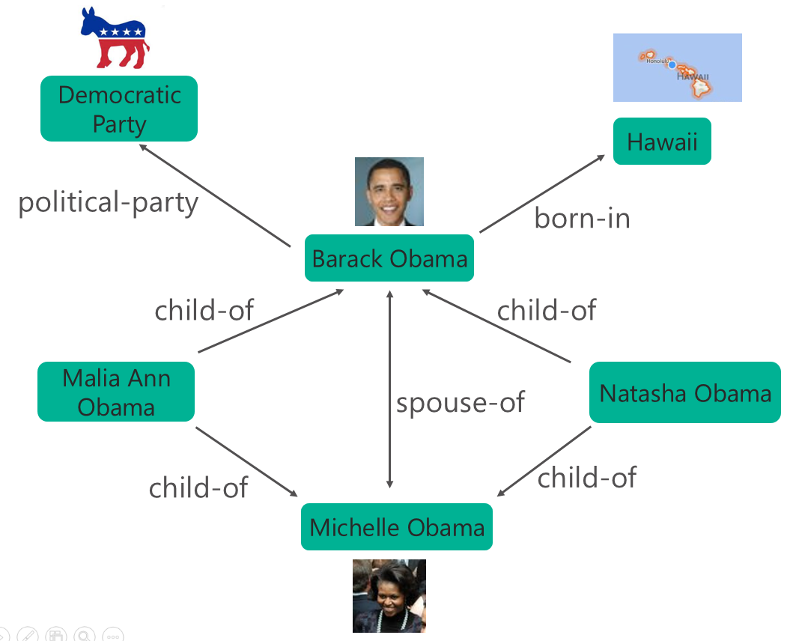
Knowledge Base
Captures world knowledge by storing properties of millions of entities, as well as relations among them
Freebase
DBpedia
YAGO
NELL
OpenIE/ReVerb
Useful resources for NLP applications
Semantic Parsing & Question Answering [e.g., Berant+, 2014]
Information Extraction [Riedel+, 2013]

Slide 3
Reasoning with Knowledge Base
Knowledge base is never complete!
Extract previously unknown facts from new corpora
Predict new facts via inference
Modeling multi-relational data
Statistical relational learning [Getoor & Taskar, 2007]
Path ranking methods (e.g., random walk) [e.g., Lao+ 2011]
Knowledge base embedding
Very efficient
Better prediction accuracy

Slide 4
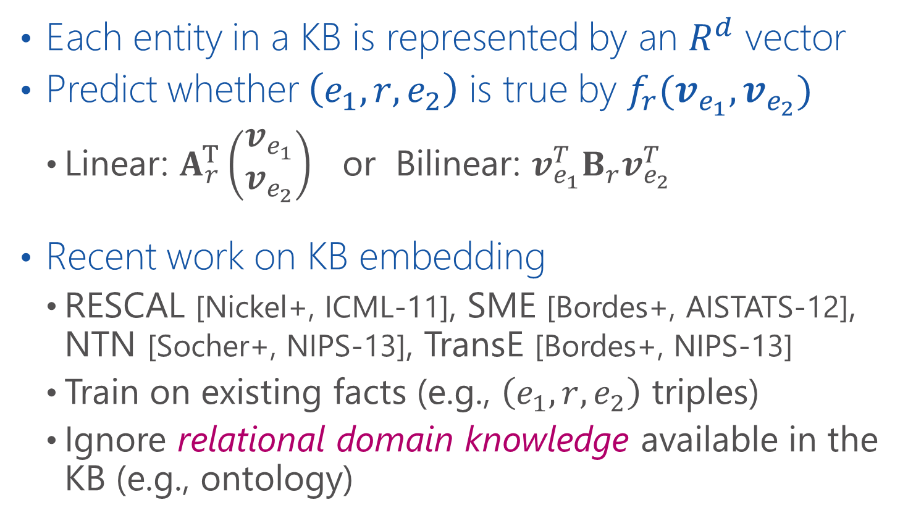
Knowledge Base Embedding
Each entity in a KB is represented by an $R^{d}$ vector
Predict whether $\left(e_{1}, r, e_{2}\right)$ is true by $f_{r}(v_{e_{1}}, v_{e_{2}})$
Linear: $A_{r}^{T}\left(\begin{aligned}v_{e_{1}} \\ v_{e_{2}}\end{aligned}\right)$ or Bilinear: $v_{e_{1}}^{T}B_{r}v_{e_{2}}^{T}$
Recent work on KB embedding
RESCAL [Nickel+, ICML-11], SME [Bordes+, AISTATS-12], NTN [Socher+, NIPS-13], TransE [Bordes+, NIPS-13]
Train on existing facts (e.g., $\left(e_{1},r, e_{2}\right)$ triples)
Ignore relational domain knowledge available in the KB (e.g., ontology)

Slide 5
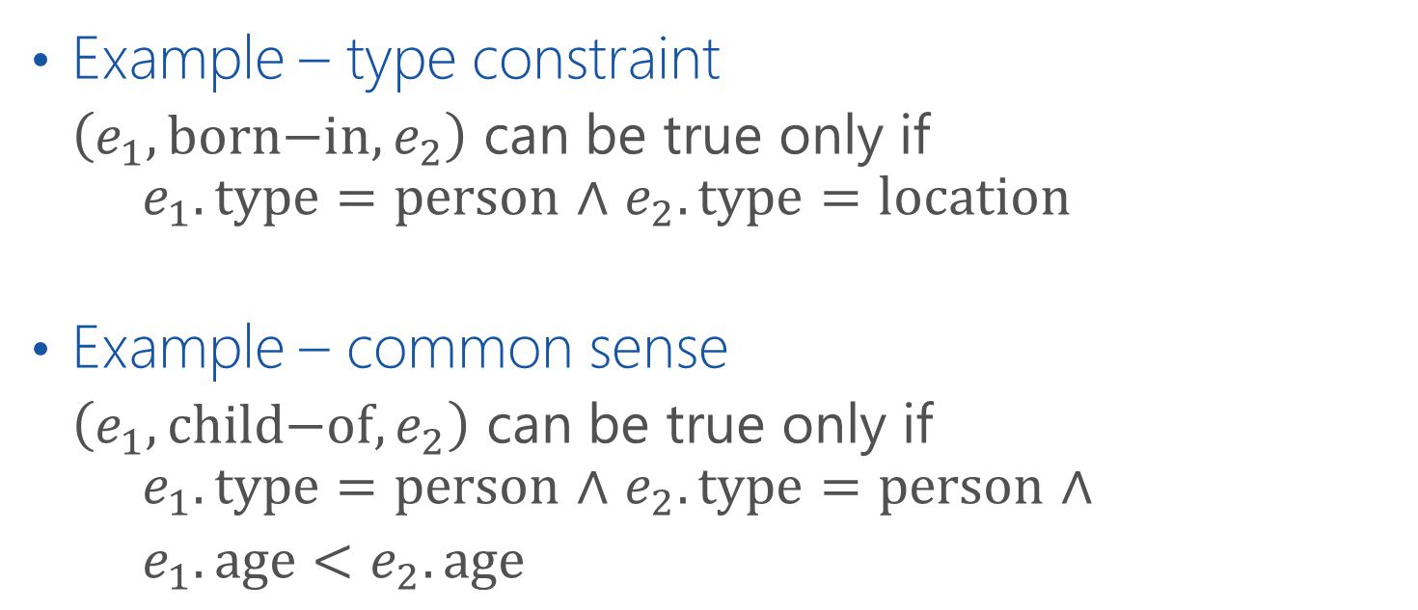
Relational Domain Knowledge
Example – type constraint
$\left(e_{1},\text{born}\text{−}\text{in},e_{2}\right)$ can be true only if $e_{1}.\text{type}=\text{person}$ $∧$ $e_{2}.\text{type}=\text{location}$
Example – common sense
$\left(e_{1},\text{child}\text{−}\text{of}, e_{2}\right)$ can be true only if $e_{1}.\text{type}=\text{person}$ $∧$ $e_{2}.\text{type}=\text{person}$ $∧$
$e_{1}.\text{age}<e_{2}.\text{age}$

Slide 6
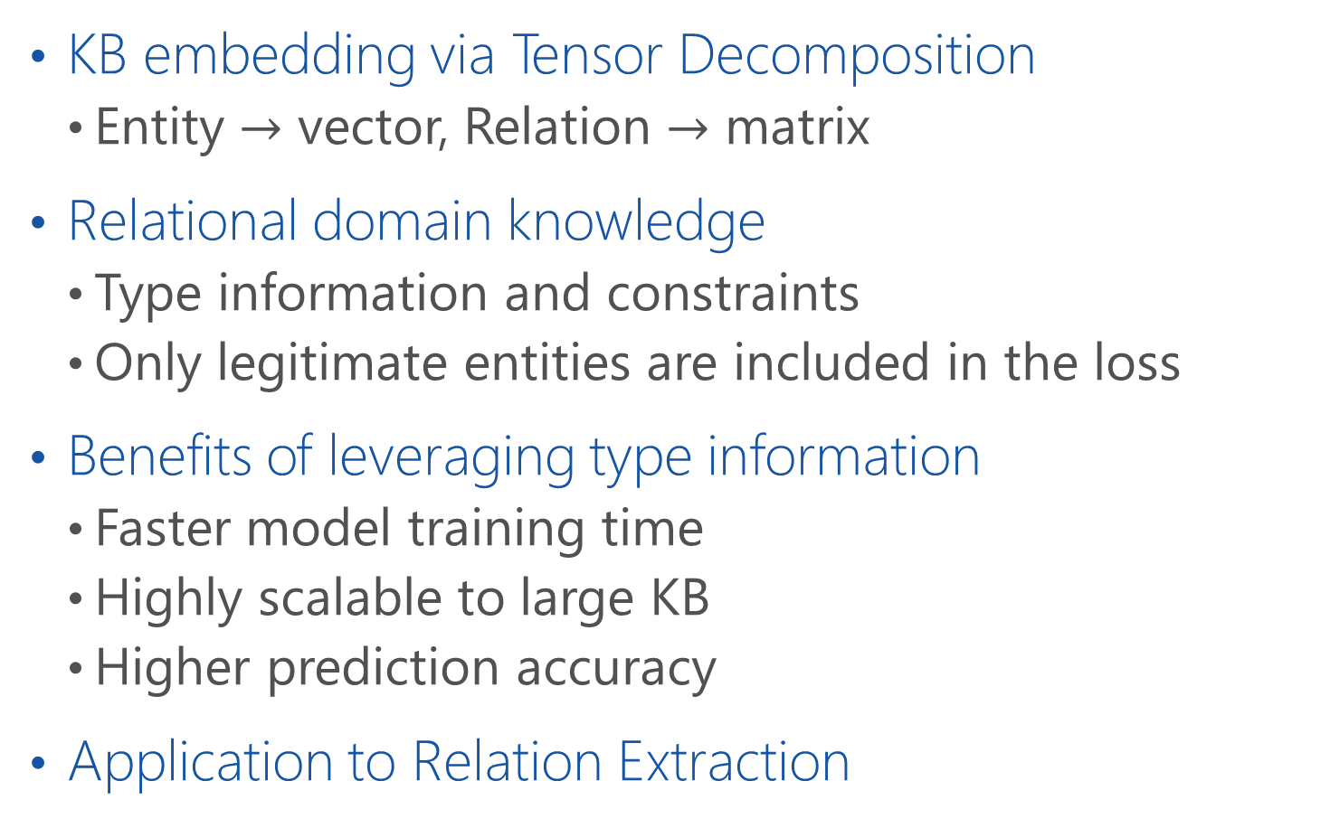
Typed Tensor Decomposition – TRESCAL
KB embedding via Tensor Decomposition
Entity $→$ vector, Relation $→$ matrix
Relational domain knowledge
Type information and constraints
Only legitimate entities are included in the loss
Benefits of leveraging type information
Faster model training time
Highly scalable to large KB
Higher prediction accuracy
Application to Relation Extraction

Slide 7
Road Map
Introduction
KB embedding via Tensor Decomposition
Typed tensor decomposition (TRESCAL)
Experiments
Discussion & Conclusions

Slide 8
Knowledge Base Representation (1/2)
Collection of subj-pred-obj triples – $(e_{1}, r, e_{2})$
Subject | Predicate | Object
Obama | Born-in | Hawaii
Bill Gates | Nationality | USA
Bill Clinton | Spouse-of | Hillary Clinton
Satya Nadella | Work-at | Microsoft
… | … | …

Slide 9
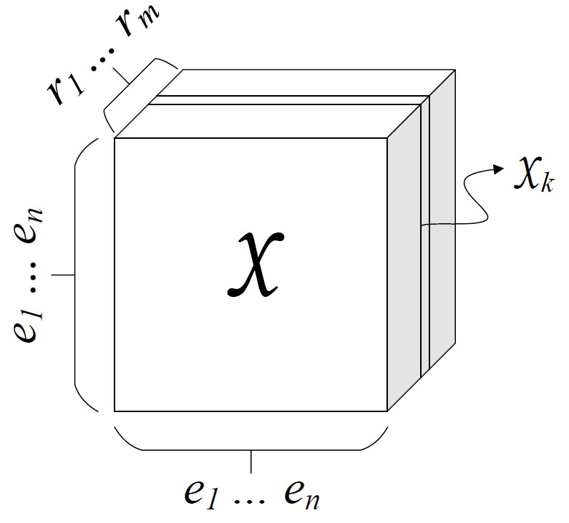

Knowledge Base Representation (1/2)
Collection of subj-pred-obj triples – $(e_{1}, r, e_{2})$
Subject | Predicate | Object
Obama | Born-in | Hawaii
Bill Gates | Nationality | USA
Bill Clinton | Spouse-of | Hillary Clinton
Satya Nadella | Work-at | Microsoft
… | … | …
$n$: # entities, $m$: # relations

Slide 10
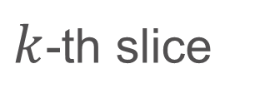
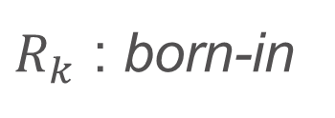

Knowledge Base Representation (2/2)
$k$-th slice
$$𝒳_{k}$$
Hawaii
Obama
1
$R_{k}$ : born-in

Slide 11
Knowledge Base Representation (2/2)
$k$-th slice
$$𝒳_{k}$$
Hawaii
Obama
1
A zero entry means either:
Incorrect (false)
Unknown
$R_{k}$ : born-in

Slide 12


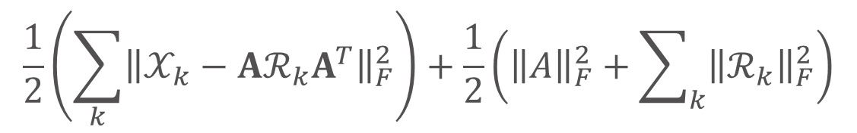



Tensor Decomposition Objective
$$\frac{1}{2}\left(\sum_{k}{{\left\|𝒳_{k}−Aℛ_{k}A^{T}\right\|}_{F}^{2}}\right)+\frac{1}{2}\left({\left\|A\right\|}_{F}^{2}+\sum_{k}{{\left\|ℛ_{k}\right\|}_{F}^{2}}\right)$$
Objective:
Reconstruction Error
Regularization
$$𝒳_{k}$$
$$A$$
$$ℛ_{k}$$
$$A^{T}$$
~
×
×
~
$k$-th relation
RESCAL [Nickel+, ICML-11]

Slide 13
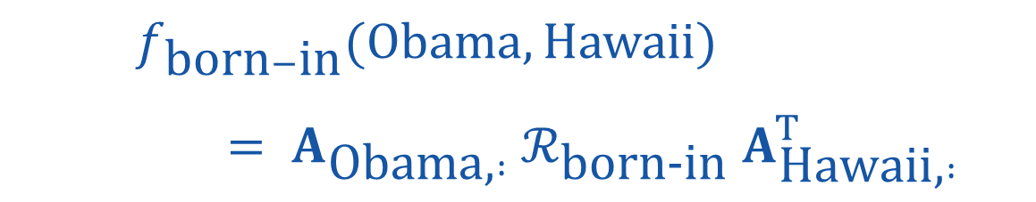
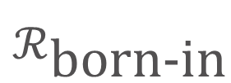


Measure the Degree of a Relationship
$f_{\text{born}−\text{i}\text{n}}(\text{Obama},\text{Hawaii})$
$= A_{\text{Obama}\text{,} :} ℛ_{\text{born}\text{−}\text{in}} A_{\text{Hawaii}\text{,} :}^{T}$
$$A$$
Hawaii
$$ℛ_{\text{born}\text{−}\text{in}}$$
$$A^{T}$$
×
×
Obama

Slide 14
Road Map
Introduction
KB embedding via Tensor Decomposition
Typed tensor decomposition (TRESCAL)
Basic idea
Training procedure
Complexity analysis
Experiments
Discussion & Conclusions

Slide 15
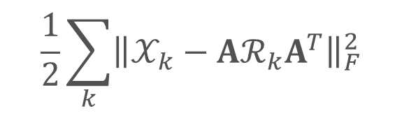




Typed Tensor Decomposition Objective
$$\frac{1}{2}\sum_{k}{{\left\|𝒳_{k}−Aℛ_{k}A^{T}\right\|}_{F}^{2}}$$
Reconstruction error:
$$𝒳_{k}$$
$$A$$
$$ℛ_{k}$$
$$A^{T}$$
~
×
×
~

Slide 16



Typed Tensor Decomposition Objective
$$\frac{1}{2}\sum_{k}{{\left\|𝒳_{k}−Aℛ_{k}A^{T}\right\|}_{F}^{2}}$$
Reconstruction error:
$$𝒳_{k}$$
$$A$$
$$ℛ_{k}$$
$$A^{T}$$
~
×
×
~
Relation: born-in

Slide 17
Typed Tensor Decomposition Objective
$$\frac{1}{2}\sum_{k}{{\left\|𝒳_{k}−Aℛ_{k}A^{T}\right\|}_{F}^{2}}$$
Reconstruction error:
$$𝒳_{k}$$
$$A$$
$$ℛ_{k}$$
$$A^{T}$$
~
×
×
~
people
Relation: born-in

Slide 18
Typed Tensor Decomposition Objective
$$\frac{1}{2}\sum_{k}{{\left\|𝒳_{k}−Aℛ_{k}A^{T}\right\|}_{F}^{2}}$$
Reconstruction error:
locations
$$𝒳_{k}$$
$$A$$
$$ℛ_{k}$$
$$A^{T}$$
~
×
×
~
people
Relation: born-in

Slide 19
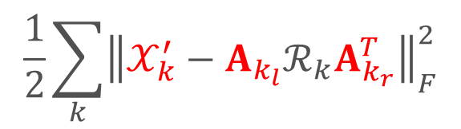




Typed Tensor Decomposition Objective
$$\frac{1}{2}\sum_{k}{{\left\|𝒳_{k}^{′}−A_{k_{l}}ℛ_{k}A_{k_{r}}^{T}\right\|}_{F}^{2}}$$
Reconstruction error:
$$𝒳_{k}^{′}$$
$$A_{k_{l}}$$
$$ℛ_{k}$$
$$A_{k_{r}}^{T}$$
~
×
×
~

Slide 20

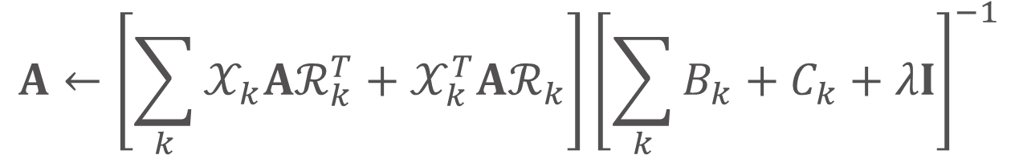

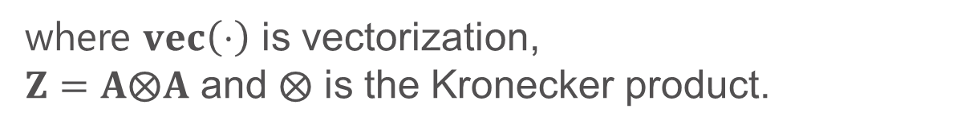
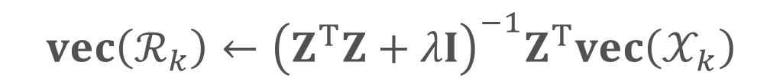

Training Procedure – Alternating Least-Squares (ALS) Method
Fix $ℛ_{k}$, update $A$
$$A←\left[\sum_{k}{𝒳_{k}Aℛ_{k}^{T}+𝒳_{k}^{T}Aℛ_{k}}\right]{\left[\sum_{k}{B_{k}+C_{k}+λI}\right]}^{−1}$$
where $B_{k}=ℛ_{k}A^{T}Aℛ_{k}^{T}\text{, }C_{k}=ℛ_{k}^{T}A^{T}Aℛ_{k}$.
Fix $A$, update $ℛ_{k}$
$$vec\left(ℛ_{k}\right)←{\left(Z^{T}Z+λI\right)}^{−1}Z^{T}vec\left(𝒳_{k}\right)$$
where $vec\left(⋅\right)$ is vectorization, $Z=A⨂A$ and $⨂$ is the Kronecker product.

Slide 21
Training Procedure – Alternating Least-Squares (ALS) Method
$$A←\left[\sum_{k}{𝒳_{k}Aℛ_{k}^{T}+𝒳_{k}^{T}Aℛ_{k}}\right]{\left[\sum_{k}{B_{k}+C_{k}+λI}\right]}^{−1}$$
where $B_{k}=ℛ_{k}A^{T}Aℛ_{k}^{T}\text{, }C_{k}=ℛ_{k}^{T}A^{T}Aℛ_{k}$.
Fix $A$, update $ℛ_{k}$
$$vec\left(ℛ_{k}\right)←{\left(Z^{T}Z+λI\right)}^{−1}Z^{T}vec\left(𝒳_{k}\right)$$
where $vec\left(⋅\right)$ is vectorization, $Z=A⨂A$ and $⨂$ is the Kronecker product.

Slide 22
Training Procedure – Alternating Least-Squares (ALS) Method
$$A←\left[\sum_{k}{𝒳_{k}Aℛ_{k}^{T}+𝒳_{k}^{T}Aℛ_{k}}\right]{\left[\sum_{k}{B_{k}+C_{k}+λI}\right]}^{−1}$$
where $B_{k}=ℛ_{k}A^{T}Aℛ_{k}^{T}\text{, }C_{k}=ℛ_{k}^{T}A^{T}Aℛ_{k}$.
$$vec\left(ℛ_{k}\right)←{\left(Z^{T}Z+λI\right)}^{−1}Z^{T}vec\left(𝒳_{k}\right)$$
where $vec\left(⋅\right)$ is vectorization, $Z=A⨂A$ and $⨂$ is the Kronecker product.

Slide 23
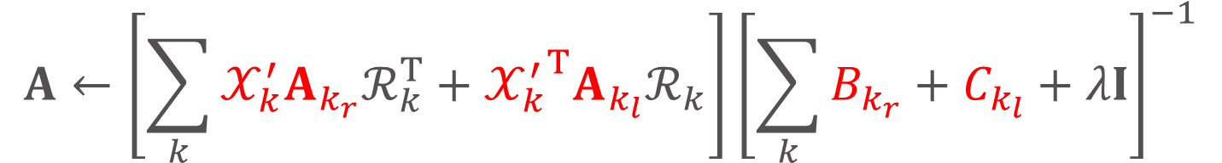
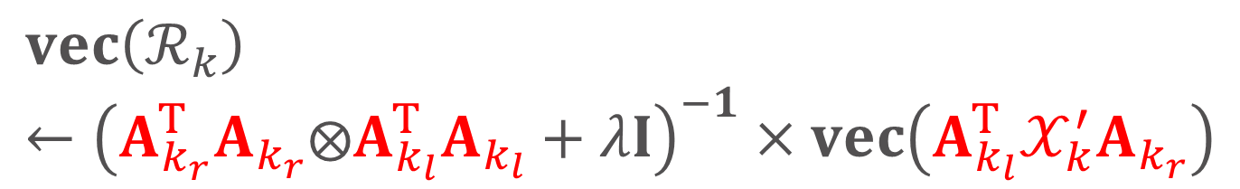
Training Procedure – Alternating Least-Squares (ALS) Method
$$A←\left[\sum_{k}{𝒳_{k}^{′}A_{k_{r}}ℛ_{k}^{T}+{𝒳_{k}^{′}}^{T}A_{k_{l}}ℛ_{k}}\right]{\left[\sum_{k}{B_{k_{r}}+C_{k_{l}}+λI}\right]}^{−1}$$
where $B_{k_{r}}=ℛ_{k}A_{k_{r}}^{T}A_{k_{r}}ℛ_{k}^{T}\text{, }C_{k_{l}}=ℛ_{k}^{T}A_{k_{l}}^{T}A_{k_{l}}ℛ_{k}$.
$$vec\left(ℛ_{k}\right)←{\left(A_{k_{r}}^{T}A_{k_{r}}⨂A_{k_{l}}^{T}A_{k_{l}}+λI\right)}^{−1}×vec\left({A_{k_{l}}^{T}𝒳}_{k}^{′}A_{k_{r}}\right)$$

Slide 24
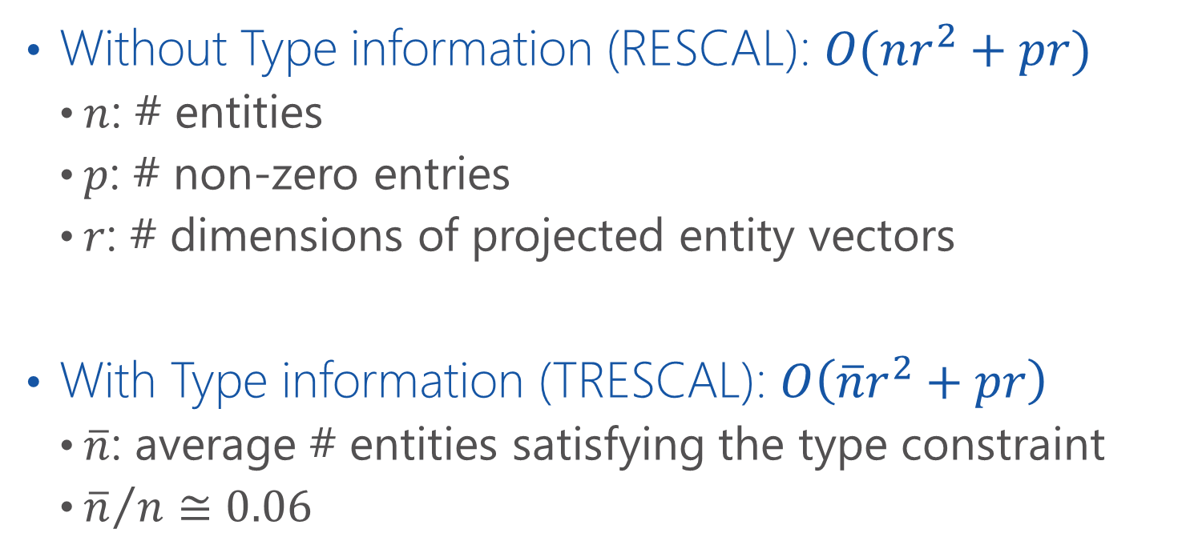
Complexity Analysis
Without Type information (RESCAL): $O(nr^{2}+pr)$
$n$: # entities
$p$: # non-zero entries
$r$: # dimensions of projected entity vectors
With Type information (TRESCAL): $O\left(\overline{n}r^{2}+pr\right)$
$\overline{n}$: average # entities satisfying the type constraint
${\overline{n}}/{n≅0.06}$

Slide 25
Road Map
Introduction
KB embedding via Tensor Decomposition
Typed tensor decomposition (TRESCAL)
Experiments
KB Completion
Application to Relation Extraction
Discussion & Conclusions

Slide 26
Experiments – KB Completion
KB – Never Ending Language Learning (NELL)
Training: version 165
Developing: new facts between v.166 and v.533
Testing: new facts between v.534 and v.745
Data statistics of the training set
# Entities | 753k
# Relation Types | 229
# Entity Types | 300
# Entity-Relation Triples | 1.8M

Slide 27
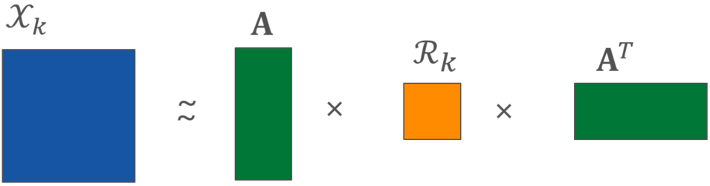

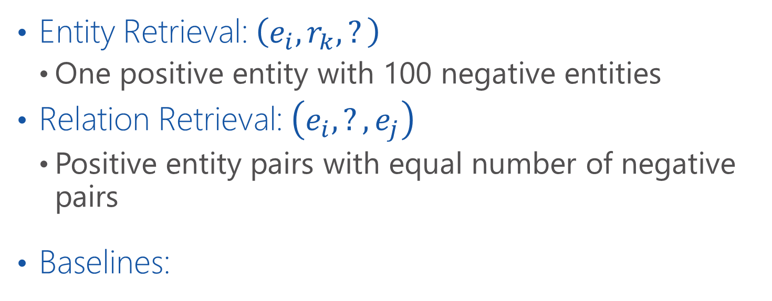


Tasks & Baselines
Entity Retrieval: $\left(e_{i}, r_{k}, ?\right)$
One positive entity with 100 negative entities
Relation Retrieval: $\left(e_{i}, ?, e_{j}\right)$
Positive entity pairs with equal number of negative pairs
Baselines:
$$r_{k}$$
$$e_{i}$$
$$e_{j}$$
RESCAL [Nickel+, ICML-11]
TransE [Bordes+, NIPS-13]

Slide 28
Training Time Reduction
4.6x speed-up
Both models finish training in 10 iterations.
TRESCAL filters 96% entity triples with incompatible types.

Slide 29
Training Time Reduction
21.5x speed-up
# iterations for TransE is set to 500 (the default value).

Slide 30

Entity Retrieval $\left(e_{i}, r_{k}, ?\right)$

Slide 31

Relation Retrieval $\left(e_{i}, ?, e_{j}\right)$

Slide 32

Experiments – Relation Extraction
Satya Nadella is the CEO of Microsoft.
(Satya Nadella , work-at, Microsoft)

Slide 33
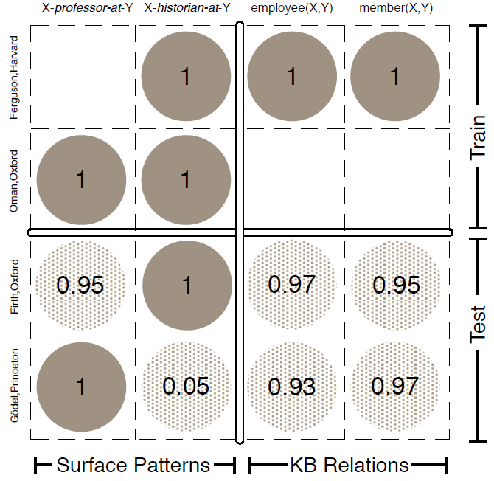
Relation Extraction as Matrix Factorization [Riedel+ 13]
Row: Entity Pair
Column: Relation
Fig.1 of [Riedel+ 13]

Slide 34
Data & Task Description
Raw data: NY Times corpus & Freebase
Entities in NY Times and Freebase are aligned
Raw tensor construction
80,698 entities & 1,652 relations
Type information from Freebase & NER
Type constraints are derived from training data
Task – identify FB relations of entity pairs in text
10,000 entity pairs: 2,048 have both entities in FB
Evaluation metric – Weighted mean average precision (MAP) on 19 relations

Slide 35
Relation Extraction
Evaluated using only 2,048 FB entity pairs
[updated version]

Slide 36
Relation Extraction
Evaluated using all 10,000 entity pairs

Slide 37
Conclusions
TRESCAL: A KB embedding model via tensor decomposition
Leverages entity type constraint
Faster model training time
Highly scalable to large KB
Higher prediction accuracy
Application to relation extraction
Challenges & Future Work
Capture more types of relational domain knowledge
Support more sophisticated inferential tasks

